Slide 1
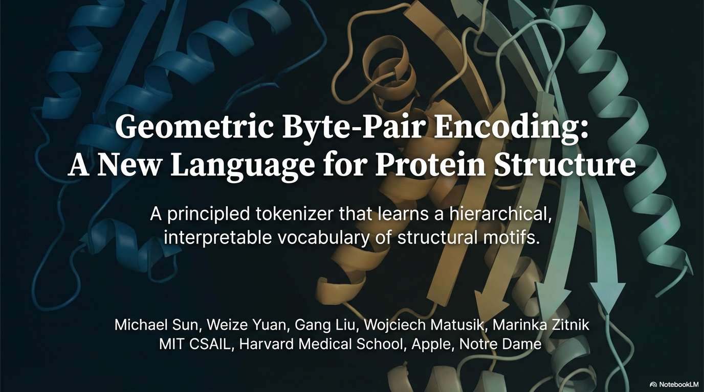

Slide 2
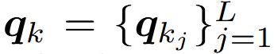


Motivation
Most popular Protein Structure Tokenizers (PST): Vector Quantized Variational Auto Encoder (VQ-VAE)
Codebook
Look-up minimum distance
Structure x
Encoder
Continuous Representation z
Quantized Vector $$q_{∗}$$
Decoder
Structure $$\tilde{x}≈x$$
Notes:
Vector Quantized Variational Auto Encoder
Used by ESM3, Foldseek etc

Slide 3
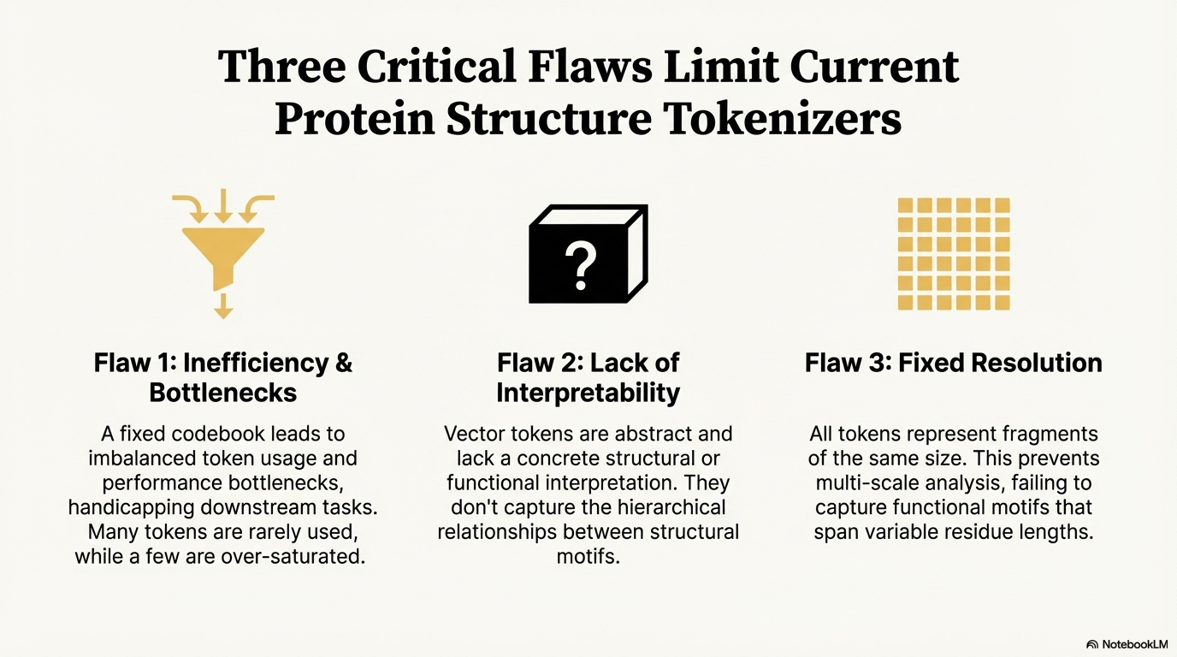
Motivation
Most popular Protein Structure Tokenizers (PST): VQ-VAE
Notes:
Used by ESM3, Foldseek etc

Slide 4
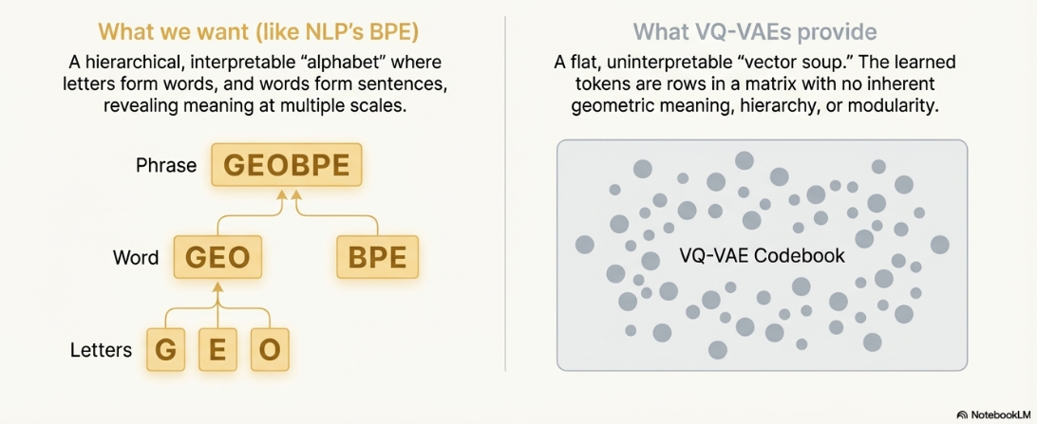
Motivation
Most popular Protein Structure Tokenizers (PST): VQ-VAE
Notes:
Used by ESM3, Foldseek etc BPE: Byte-Pair Encoding

Slide 5
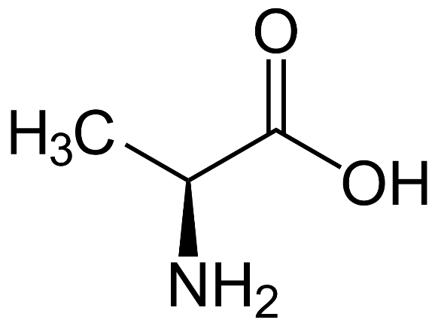
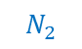
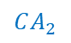
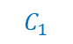
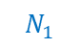
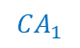
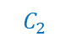
Global Backbone Formulation
Backbone Atoms and Peptide Bond
$$C_{2}$$
$$CA_{2}$$
$$N_{2}$$
$$C_{1}$$
$$CA_{1}$$
$$N_{1}$$
Notes:
L-Alanine
amino (NH2) and carboxylic acid (COOH) groups.
Alpha carbon
Protein backbone can be represented by the coordinates of three key atoms per residue: nitrogen (N), Alpha Carbon (CA) and carboxyl carbon (C).

Slide 6
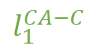
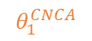
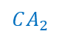
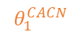
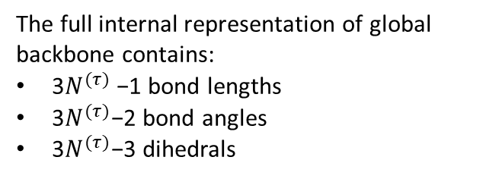
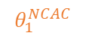
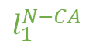
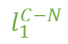
Global Backbone Formulation
Lengths and bond angles
The full internal representation of global backbone contains:
3$N^{(τ)}$−1 bond lengths
3$N^{(τ)}$−2 bond angles
3$N^{(τ)}$−3 dihedrals
$$C_{2}$$
$$CA_{2}$$
$$θ_{1}^{CNCA}$$
$$l_{1 }^{CA−C}$$
$$N_{2}$$
$$θ_{1 }^{CACN}$$
$$CA_{1}$$
$$C_{1}$$
$$l_{1 }^{C−N}$$
$$l_{1 }^{N−CA}$$
$$θ_{1 }^{NCAC}$$
$$N_{1}$$

Slide 7
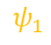
Global Backbone Formulation
Dihedrals
The full internal representation of global backbone contains:
3$N^{(τ)}$−1 bond lengths
3$N^{(τ)}$−2 bond angles
3$N^{(τ)}$−3 dihedrals
$$C_{2}$$
$$CA_{2}$$
$$N_{2}$$
$$CA_{1}$$
$$C_{1}$$
$$ψ_{1}$$
$$N_{1}$$
Notes:
psi

Slide 8
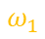
Global Backbone Formulation
Dihedrals
The full internal representation of global backbone contains:
3$N^{(τ)}$−1 bond lengths
3$N^{(τ)}$−2 bond angles
3$N^{(τ)}$−3 dihedrals
$$C_{2}$$
$$CA_{2}$$
$$N_{2}$$
$$ω_{1}$$
$$CA_{1}$$
$$C_{1}$$
$$N_{1}$$
Notes:
omega

Slide 9
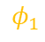
Global Backbone Formulation
Dihedrals
$$φ_{1}$$
The full internal representation of global backbone contains:
3$N^{(τ)}$−1 bond lengths
3$N^{(τ)}$−2 bond angles
3$N^{(τ)}$−3 dihedrals
$$C_{2}$$
$$CA_{2}$$
$$N_{2}$$
$$CA_{1}$$
$$C_{1}$$
$$N_{1}$$
Notes:
phi

Slide 10

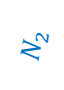
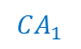

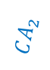

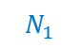
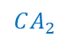

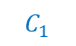
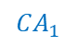

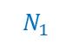
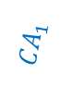

Global Backbone Formulation
Invariant to any g = (R, t) ∈ SE(3)
$$C_{2}$$
$$CA_{2}$$
$$C_{2}$$
$$C_{2}$$
$$CA_{2}$$
$$CA_{2}$$
$$N_{2}$$
$$N_{2}$$
$$N_{2}$$
$$CA_{1}$$
$$C_{1}$$
$$CA_{1}$$
$$C_{1}$$
$$CA_{1}$$
$$C_{1}$$
$$N_{1}$$
$$N_{1}$$
$$N_{1}$$
Notes:
SE(3): Special Euclidean Group in 3 Dimensions:
two components: 1. A rotation matrix (R∈SO(3)). (special orthogonal group, rotation around axis) 2. A translation vector (t∈R^3). (movement along x, y, z axis)

Slide 11
Local Formulation
Bond-Residue
$$C_{2}$$
$$CA_{2}$$
$$l_{1 }^{CA−C}$$
$$N_{2}$$
$$θ_{1 }^{CACN}$$
$$CA_{1}$$
$$C_{1}$$
$$l_{1 }^{C−N}$$
$$ψ_{1}$$
$$θ_{1 }^{NCAC}$$
$$l_{1 }^{N−CA}$$
$$N_{1}$$

Slide 12
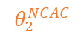
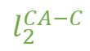
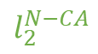
Local Formulation
Last Bond-Residue
$$l_{2}^{CA−C}$$
$$C_{2}$$
$$CA_{2}$$
$$θ_{2 }^{NCAC}$$
$$l_{2}^{N−CA}$$
$$N_{2}$$
$$CA_{1}$$
$$C_{1}$$
$$N_{1}$$

Slide 13
Glue Parameters
Defined Between Neighbouring Bond-Residues
$$C_{2}$$
$$CA_{2}$$
$$N_{2}$$
$$CA_{1}$$
$$C_{1}$$
$$N_{1}$$

Slide 14
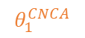
Glue Parameters
$$θ_{i}^{CNCA}$$
$$C_{2}$$
$$CA_{2}$$
$$θ_{1 }^{CNCA}$$
$$N_{2}$$
$$CA_{1}$$
$$C_{1}$$
$$N_{1}$$
Notes:
Teta

Slide 15
Glue Parameters
$$ω_{i}^{ }$$
$$C_{2}$$
$$CA_{2}$$
$$N_{2}$$
$$ω_{1}$$
$$CA_{1}$$
$$C_{1}$$
$$N_{1}$$
Notes:
omega

Slide 16
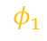
Glue Parameters
$$φ_{i}^{ }$$
$$φ_{1}$$
$$C_{2}$$
$$CA_{2}$$
$$N_{2}$$
$$CA_{1}$$
$$C_{1}$$
$$N_{1}$$
Notes:
phi

Slide 17
Glue Parameters
Defined Between Neighbouring Bond-Residues
$$φ_{1}$$
$$C_{2}$$
$$CA_{2}$$
$$θ_{1 }^{CNCA}$$
$$N_{2}$$
$$ω_{1}$$
$$CA_{1}$$
$$C_{1}$$
$$N_{1}$$

Slide 18
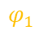
Motif Formulation
Includes all bond-residue and glue parameters
$$φ_{1}$$
$$C_{2}$$
$$CA_{2}$$
$$θ_{2 }^{NCAC}$$
$$θ_{1 }^{CNCA}$$
$$N_{2}$$
$$θ_{1 }^{CACN}$$
$$ω_{1}$$
$$CA_{1}$$
$$C_{1}$$
$$φ_{1}$$
$$θ_{1 }^{NCAC}$$
$$N_{1}$$

Slide 19

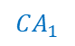
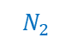
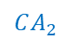
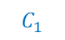
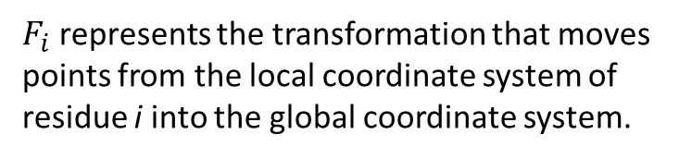
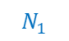
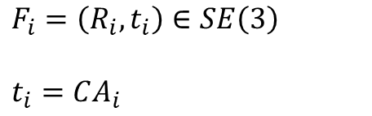
Entry/Exit Frames
Axes used to define coordinates in residue frames
$$F_{i}=\left(R_{i}, t_{i}\right)∈SE\left(3\right)$$
$$t_{i}=CA_{i}$$
$$C_{2}$$
$$CA_{2}$$
z
$$N_{2}$$
$F_{i}$ represents the transformation that moves points from the local coordinate system of residue i into the global coordinate system.
x
$$CA_{1}$$
$$C_{1}$$
$$N_{1}$$
y (normalized CA-N)

Slide 20
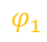
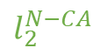
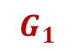
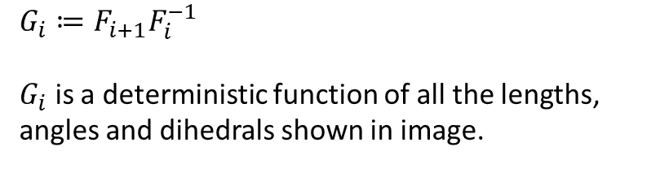
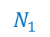
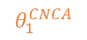














Transforms
Per-Link Transform
$$CA_{2}$$
$$C_{2}$$
$$G_{1}$$
$$G_{i}≔F_{i+1}F_{i}^{−1}$$
$G_{i}$ is a deterministic function of all the lengths, angles and dihedrals shown in image.
$$N_{2}$$
$$CA_{1}$$
$$C_{1}$$
$$φ_{1}$$
$$C_{2}$$
$$N_{1}$$
$$CA_{2}$$
$$l_{2}^{N−CA}$$
$F_{i}^{−1}$represents the transformation that moves points from the global coordinate system back into the local coordinate system of residue i.
$$θ_{1 }^{CNCA}$$
$$l_{1 }^{CA−C}$$
$$N_{2}$$
$$θ_{1 }^{CACN}$$
$$ω_{1}$$
$$CA_{1}$$
$$C_{1}$$
$$l_{1 }^{C−N}$$
$$φ_{1}$$
$$θ_{1 }^{NCAC}$$
$$N_{1}$$
Notes:
G defines the transformation from one frame to the next during the linking event of two motifs.

Slide 21





Transforms
Entry / Exit Transforms
The internal entry → exit transform for a motif $ℳ_{p:q}$ is defined as:
$$T_{p:q}^{int}=F_{p:q}^{exit}{\left(F_{p:q}^{entry}\right)}^{−1}=G_{q−1}…G_{p}^{ }$$
$$C_{2}$$
$$CA_{3}$$
$$CA_{2}$$
$$N_{3}$$
$$N_{2}$$
$$C_{3}$$
$$CA_{1}$$
$$C_{1}$$
$$N_{1}$$
Notes:
Can be defined as a chain function

Slide 22
The Algorithm
Explaining Key Steps
Empirical quantizer estimation: Samples of all nine internal coordinates (lengths, angles, and dihedrals) across all protein backbones are collected, circular histograms for the angles and linear histograms for lengths are built, and quantizers are defined by snapping to the resulting bin centers.
Per-Residue Initialization: Quantization is applied to all individual residues to map each residue into a prototype. For each backbone a binary forest whose leaves are individual bond-residues is initialized. The vocabulary is initialized with residue level keys and corresponding prototypes.
Global Glue Refinement: All internal motifs are replaced with medoids, original glue parameters are used between motifs for initialization. All glue parameters are optimized by differentiable inverse kinematics (IK) to minimize error both in rotation and translation between original and reconstructed coordinates. These optimized glue parameters are then again quantized using precomputed glue quantizers.
Building Geo-Pairs: scans the entire corpus to identify all adjacent motif pairs, quantizes their geometric boundaries into a canonical key, and creates a priority-ordered map of these Geo-Pair occurrences based on frequency, which dictates the order of motif merging
BPE loop: Analogous to a single merge iteration in standard BPE, this step identifies the most frequent adjacent structural motif pair (Geo-Pair), clusters its occurrences to create new prototypes, and then globally corrects the geometry introduced by this quantization. At each step it updates the segmentation and hierarchy.

Slide 23

The Algorithm
Explaining Key Steps
Empirical quantizer estimation: Samples of all nine internal coordinates (lengths, angles, and dihedrals) across all protein backbones are collected, circular histograms for the angles and linear histograms for lengths are built, and quantizers are defined by snapping to the resulting bin centers.
Histograms
Quantizers
Lengths, angles,
dihedrals
Notes:
Number of bins: 500
Aslında bu quantization sadece glue parameterlar için kullanılıyor.

Slide 24
The Algorithm
Explaining Key Steps
2. Per-Residue Initialization: Clustering is applied to all individual residues to map each residue into a prototype using k-medoids. For each backbone a binary forest whose leaves are individual bond-residues is initialized. The vocabulary is initialized with residue level keys and corresponding prototypes.
…

Slide 25

The Algorithm
K-Medoids Clustering
Coordinate Computation: For every occurrence u in the input set S, the Cartesian coordinates ($x_{u}$) of its backbone atoms are computed.
Subsampling (Optional): If the total number of occurrences M exceeds a maximum cap $m_{max}$​, a uniform sample without replacement (A⊆S) of size min($m$, $m_{max}$​) is taken. This subsampling is used to manage computational complexity.
Distance Matrix Construction: A pairwise distance matrix (D) is built, where the distance between any two fragments u and v is calculated using the Kabsch RMSD metric: $D_{uv}=KABSCH_RMSD(X_{u}, X_{v})$
k-Medoids Clustering: The algorithm then performs iterative k-medoids clustering on the distance matrix D:
Initialization: K distinct medoid indices $(m_{1},…,m_{k})$ are chosen uniformly from the sampled set A.
Assignment: Every fragment occurrence u in the set A is assigned to its closest current medoid $m_{j}$. $c\left(u\right)←argmin_{j}D_{u,m_{j}}$
Update: For each cluster $C_{j}$ (the set of fragments assigned to medoid $m_{j}$), a new medoid $m_{j}^{′}$ is selected. The new medoid is the fragment within $C_{j}$ that minimizes the sum of its distances to all other members of the cluster (it is the center point of the cluster in terms of distance).
Convergence: The iteration stops if the total change in medoid cost is below a tolerance ϵ or after a maximum number of iterations T.
Final Assignment: Once the K medoids ($\hat{M}$) have been finalized (as observed fragments in S), every original occurrence u∈S is assigned to its final closest medoid based on Kabsch RMSD.
Notes:
Internal cartesian coordinates are used
RMSD is calculated on the optimally aligned coordinates of two segments.

Slide 26


The Algorithm
Explaining Key Steps
Drift Introduction: When a motif occurrence in a protein is quantized by replacing its continuous internal parameters with the exact internal geometry of a discrete prototype (medoid), a discrepancy ($ΔT_{u}$​) is introduced between the original structural transformation ($T_{u}^{occ}$​) and the medoid's transformation ($T_{u}^{med}$​).

Slide 27










The Algorithm
Explaining Key Steps
3. Global Glue Refinement: All internal motifs are replaced with medoids, original glue parameters are used between motifs for initialization. All glue parameters are optimized by running forward kinematics (FK) and backpropogating the loss (inverse kinematics (IK)) to minimize error both in rotation and translation between original and reconstructed coordinates. These optimized glue parameters are then again quantized using precomputed glue quantizers.
$$φ_{1}$$
$$C_{2}$$
$$CA_{2}$$
$$C_{2}$$
$$CA_{2}$$
$$θ_{1 }^{CNCA}$$
$$N_{2}$$
$$N_{2}$$
$$ω_{1}$$
$$CA_{1}$$
$$C_{1}$$
$$CA_{1}$$
$$C_{1}$$
$$N_{1}$$
$$N_{1}$$

Slide 28



The Algorithm
Explaining Key Steps
4. Building Geo-Pairs Priority Map: scans the entire corpus to identify all adjacent motif pairs, quantizes their geometric boundaries into a canonical key, and creates a priority-ordered map of these Geo-Pair occurrences based on frequency, which dictates the order of motif merging
$$M_{2}$$
$$CA_{2}$$
$$C_{2}$$
$$N_{2}$$
Hash ($M_{1}$, $M_{2}$) into a key
Add the key with occurence info → D
$$M_{1}$$
$$CA_{1}$$
$$C_{1}$$
$$N_{1}$$

Slide 29





The Algorithm
Explaining Key Steps
5. BPE loop: Analogous to a single merge iteration in standard BPE, this step identifies the most frequent adjacent structural motif pairs (Geo-Pair), clusters its occurrences to create new prototypes, and then globally corrects the geometry introduced by this quantization (glue refinement). At each step it updates the segmentation and hierarchy.
$$M_{2}$$
$$CA_{2}$$
$$C_{2}$$
$$M_{1−2}$$
$$C_{2}$$
$$CA_{2}$$
From D pop most frequent geo-pair ($M_{1}$, $M_{2}$)
$$M_{1}$$
$$N_{2}$$
$$N_{2}$$
$$CA_{1}$$
$$C_{1}$$
$$CA_{1}$$
$$C_{1}$$
$$N_{1}$$
$$N_{1}$$
Notes:
The number of times this loop is called controls the vocabulary size.

Slide 30
The Algorithm
Explaining Key Steps
5. BPE loop: Analogous to a single merge iteration in standard BPE, this step identifies the most frequent adjacent structural motif pair (Geo-Pair), clusters its occurrences to create new prototypes, and then globally corrects the geometry introduced by this quantization (glue refinement). At each step it updates the segmentation and hierarchy.
…

Slide 31

The Algorithm
Toy Example

Slide 32
Experiments
General Information
Datasets:
Pretraining: PDB following OpenFold2 protocol, ~48k protein chains
Held-out test sets: CAMEO, CASP14
Downstream evaluation: 8 datasets, spanning residue-level classification (ligand binding, catalytic, conserved, repeat, and epitope), residue-level regression (structural flexibility prediction), and protein level classification.
Baselines:
VQ-VAE
Inverse Folding (IF)

Slide 33

Principles of Protein Structure Tokenization
Definitions
Let $𝒳= {\left(ℝ^{3×3}\right)}^{∗}$be the space of backbone coordinate tensors and let $𝓥$ be a finite codebook. A tokenizer is a tuple $T = (V, Enc, Dec): Enc : X → V^{∗}$mapping a structure x to a finite token sequence $q = Enc(x), Dec : Im(Enc) → X$mapping $\tilde{x} = Dec(Enc(x)).$For dataset $𝒟⊂𝒳$and distortion $d : 𝒳 × 𝒳 → [0, ∞)$(e.g., Kabsch-aligned RMSD per residue), define:
where $L(T) ≥ 0$is the description length of $(V, Enc, Dec)$and $N (x)$ is the residue count; under a uniform per-token code, $L\left(Enc\left(x\right)\right)= \left|Enc\left(x\right)\right| \log_{2}|V|.$
Notes:
Left defines distortion right defines compression.
|𝐸𝑛𝑐(𝑥)| : number of tokens, log_2 |𝑉|: bits per token
In information theory, if you have a finite set of ∣V∣ symbols (your vocabulary), the minimum number of bits needed to represent any single symbol is log2​∣V∣. This is derived from the fact that 2bits=∣V∣
BPR: bits per residue

Slide 34

Experiments
Pareto Optimality
$\hat{T}$ is Pareto-optimal on D iff no $T′$satisfies $BPR(T′; D) ≤ BPR(\hat{T}; D)$and $∆(T′; D) ≤ ∆(\hat{T}; D)$, with at least one strict.
Note: GEOBPE’s training data was only ≈ 7% of ProToken and 0.02% of ESM3.
Notes:
RMSD: Root mean square deviation,
LDDT: Local Distance Difference Test: The score ranges from 0 to 1, with higher values indicating better agreement between the model and reference
distortion

Slide 35
Experiments
Out of distribution (OOD) generalization
$\hat{T}$ generalizes OOD if, on unseen test set $D_{test} ⊂ 𝒳$, $∆(T;D_{test}) ≈ ∆(T; D).$
Notes:
RMSD: Root mean square deviation
LDDT: Local Distance Difference Test: The score ranges from 0 to 1, with higher values indicating better agreement between the model and reference
distortion

Slide 36


Experiments
Token Efficiency
Notes:
UR: Utilization Rate
This codebook perplexity reflects how uniformly codes are used

Slide 37


Experiments
Downstream transfer via codebook / vocabulary
A PST should work beyond compression, and learn signals related to function. This ability is investigated by test performance on downstream tasks using vocabulary information together with a feature extractor.
Where:
$𝒱$ denotes vocabulary
$N(x)$ denotes residue count
$F_{Θ}$ denotes a parametrized pretrained feature extractor
$Ψ_{𝒱}$ denotes a feature induction function that uses learned vocabulary structure
Per residue features:
$$r_{𝒱} (x) = Ψ_{𝒱}(F_{Θ}(x)) ∈ {\left(ℝ^{d}\right)}^{N(x)}$$
For VQ-VAE model since $Θ$ and $𝒱$ are jointly learned: $r_{𝒱}^{VQ−VAE} \left(x\right)≔Enc(x)$.
For GEOBPE, they use ESM3 as feature extractor, showing how $𝒱^{GEOBPE}$ can transfer useful signals.
Notes:
RMSD: Root mean square deviation
LDDT: Local Distance Difference Test: The score ranges from 0 to 1, with higher values indicating better agreement between the model and reference

Slide 38
Experiments
Downstream transfer via codebook / vocabulary
A PST should work beyond compression, and learn signals related to function. This ability is investigated by test performance on downstream tasks using vocabulary information together with a feature extractor.
Extract Base Features: The residue-level embeddings for a protein structure are first obtained using the pretrained feature extractor (Θ), which is set to be the ESM3 feature extractor in this case (Θ←ESM3).
Generate Hierarchy: GEOBPE processes the protein structure and outputs a binary forest (F(τ)), which is a merge tree representing the hierarchical decomposition of the fold into motifs. The leaf nodes of this forest correspond to individual residues.
Propagate Embeddings (Upward Pass): The pretrained residue features (from ESM3) are used to initialize the leaf nodes of the forest. Embeddings are then aggregated and propagated upward along the parent-child relations of the hierarchy using a Tree-LSTM.
Aggregate and Contextualize (Downward Pass): A final step aggregates the forest roots into a protein-level contextual embedding, and then the contextual information is propagated back down the hierarchy to the leaf nodes.
Output Features: The final embeddings are output as vocabulary-induced features. These features provide fine-grained embeddings for localized predictions (e.g., active site prediction) and coarse-grained embeddings for global predictions (e.g., fold classification), connecting both scales through recursive aggregation.

Slide 39

Experiments
Downstream transfer via codebook / vocabulary
A PST should work beyond compression, and learn signals related to function. This ability is investigated by test performance on downstream tasks using vocabulary information together with a feature extractor.
Notes:
Continuous PST: VAE, Discrete PST: VQ-VAE

Slide 40

Case Study
Agreement with PFAM Annotations
On these datasets, they ran CATH Functional Families (FunFams) to obtain domain boundaries and compared them with GEOBPE motifs.
Note: The values in paranthesis shows scores for a random equal length segmentation.

Slide 41

Case Study
Agreement with PFAM Annotations: Domain Level Scores
For each domain, best consecutive block of predicted segments that maximizes intersection over union (IoU) is chosen for comparison.
E.g. For domain y, $S_{2:3}$ is picked. (2:3→ 3/4, 1:3→ 4/6)
Then the metrics are calculated:
Recall = $\frac{\left|D∩S\right|}{\left|D\right|}$
Precision = $\frac{\left|D∩S\right|}{\left|S\right|}$
1
4
5
3
2
Domain y
Note: Vocabulary size is not specified in the paper.
Notes:
Macro average of all domains are calculated

Slide 42
Case Study
Agreement with PFAM Annotations: Segment Level Scores
Recall = number of domains covered with IoU above a threshold / domain count
Precision = number of segments used in domain coverage / segment count
1
4
5
3
2
Domain x
Domain y
Domain z
Domain y
Note: Vocabulary size is not specified in the paper.
Notes:
Interpretation: SegPrec penalizes unused segments; SegRec penalizes missed/poorly aligned domains.
Opinion: The smaller the vocabulary the smaller the smaller the segments will be which than makes it is easy to manipulate this kind of evaluation since iou is being maximized

Slide 43


Case Study
Human Expert Analysis of Interpretability

Slide 44
Thanks…

